Slide 1
Basic Electrical Technology
TUTORIAL (L01 – L08)

Slide 2
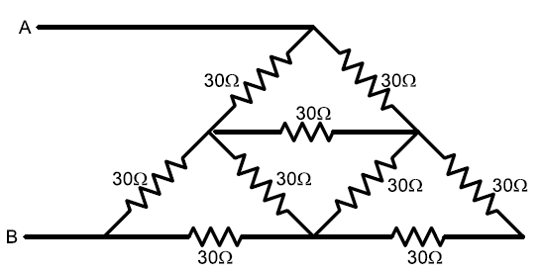
Q1
Determine the resistance between A and B in the network shown below
Ans: R_{AB} = 33.33 Ω
Notes:
100/3 or 33.33 ohms

Slide 3
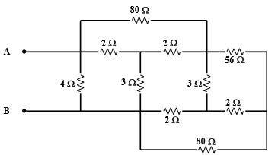
Q2
Determine the resistance between A and B in the network shown below
Ans: R_{AB} = 2 Ω
Notes:
100/3 or 33.33 ohms

Slide 4
Q3
A network of 9 conductors connects 6 points A, B, C, a, b & c as shown. The figure denotes resistances in ohms. Find
The resistance between B & b
The resistance between b & c (small)
The resistance between B & c (small)
The resistance between B & C (caps)
Answer :
1 Ω
7/12 Ω
13/12 Ω
7/12 Ω

Slide 5
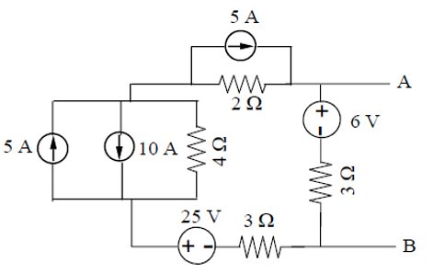
Q4
For the circuit shown below, obtain a single voltage source in series with a resistance across the output terminals by applying source transformation technique
Ans: 8.25V; 2.25 Ω
Notes:
8.25V; 2.25 ohms

Slide 6
Q5
Find the current through 8Ω resistor by source transformation method, in the circuit shown below
Ans: 150 mA
Notes:
8.25V; 2.25 ohms

Slide 7

Q6
Using node voltage method find the current flowing through 5 Ω resistor. Also find the potential difference between A & B.
Verify your answer using mesh current method.
Answer : I_{5Ω} = 0.58 A
V_{A} $−$ V_{B} = $−$3.97 V

Slide 8

Q7
For an electric network, a set of node voltage equations in matrix form is given below. Construct the network taking into account the fact that between nodes 2 and 3 there is a practical voltage source of emf 32 V and internal resistance as derived from the equations below.
$$\left[\begin{matrix}7/8 & −1/4 & −1/8 \\ −1/4 & 29/80 & −1/16 \\ −1/8 & −1/16 & 3/16\end{matrix}\right]\left[\begin{matrix}V_{1} \\ V_{2} \\ V_{3}\end{matrix}\right]=\left[\begin{matrix}−4 \\ 2 \\ 3\end{matrix}\right]$$
Network:
A
C
B
D

Slide 9
Q8
Find the voltage across 5Ω resistor using mesh current analysis
Ans: 0.714V
Notes:
100/3 or 33.33 ohms

Slide 10
Q9
Determine the power consumed by 5Ω resistor by node voltage analysis
Ans: 2.81W
Notes:
100/3 or 33.33 ohms

Slide 12
Q10
Using mesh current method, find the current delivered by 6 V voltage source in the circuit below
Ans: 2.073 A
Notes:
100/3 or 33.33 ohms

Slide 13
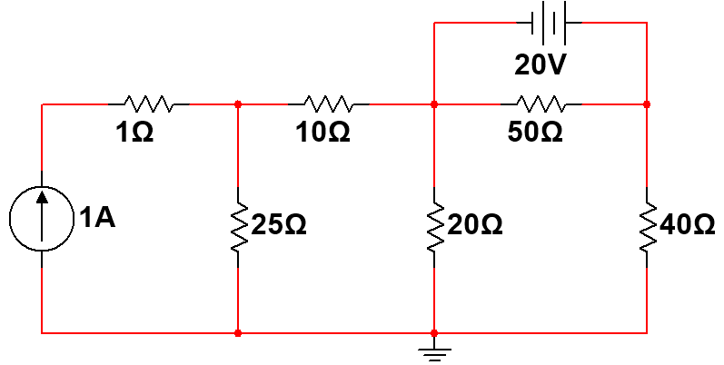
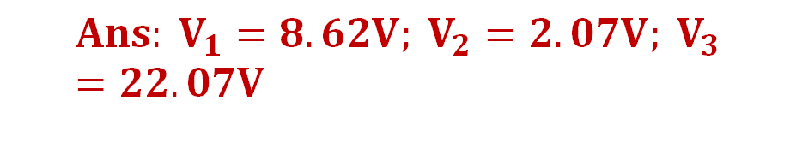
Q11
For the circuit shown in the figure, determine the node voltages 𝑉₁, 𝑉₂, 𝑉₃ using node voltage analysis. Also, find the power dissipated in 20 Ω resistor
$${Ans: V}_{1}=8.62V; V_{2}=2.07V; V_{3}=22.07V$$
P_{20Ω} = 0.2142 W
Notes:
100/3 or 33.33 ohms

Slide 14
Q12
Using mesh current analysis, determine the power dissipated by 4Ω resistor connected between node A & B
Ans: P_{4Ω} = 8.1633 W

Slide 15
Q13
What is the potential difference between points X and Y? Which point is positive with respect to the other- X or Y?
Ans:
Y is 3.7 V positive w.r.t. X

Slide 16
Q14
In the figure shown below replace the network to the left of terminals A & B by its Thevenin equivalent circuit. Hence, determine I
Answer: R_{th} = 3 Ω,
V_{th} = 20 V
I = -2 A

Slide 17
Q15
Using Superposition theorem, find the value of V_{s} if the current in 4 Ω is 0.515 A and the direction is as shown in the diagram below.
Ans: 16 V

Slide 18
Q16
Find the value of R such that maximum power is transferred to 8 Ω resistor.
Ans: 20 Ω

Slide 19
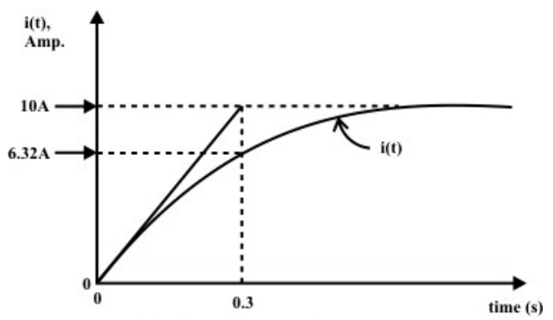
Q18
Figure below shows the plot of current $i\left(t\right)$through a series R-L circuit when a constant voltage of magnitude 50 V is applied to it. Calculate the values of resistance R and inductance L .
Ans: R = 5 Ω,
L = 1.5 H

Slide 20
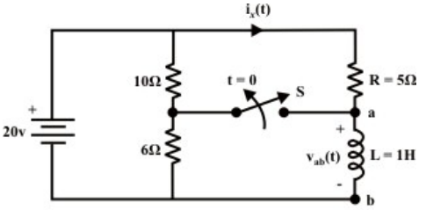
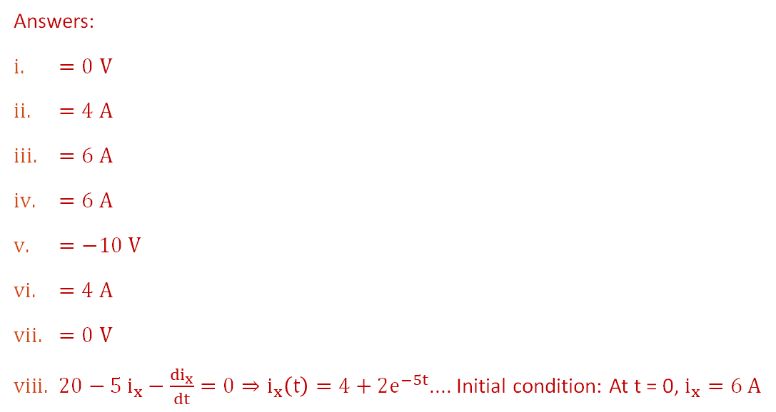

Q19
For the circuit shown in figure below, the switch S has been closed for a long time and then opens at $t=0$.
Find,
$v_{ab}(0^{−})$
$i_{x}\left(0^{−}\right)$
$i_{L}\left(0^{−}\right)$
$i_{x}(0^{+})$
$v_{ab}(0^{+})$
$i_{x}(t=∞)$
$v_{ab}(t=∞)$
$i_{x}\left(t\right), for t>0$
Answers:
$=0 V$
$=4 A$
$=6 A$
$=6 A$
$=−10 V$
$=4 A$
$=0 V$
$20−5 i_{x}−\frac{{di}_{x}}{dt}=0⇒i_{x}\left(t\right)=4+2e^{−5t}$.... Initial condition: At t = 0, $i_{x}=6 A$

Slide 21
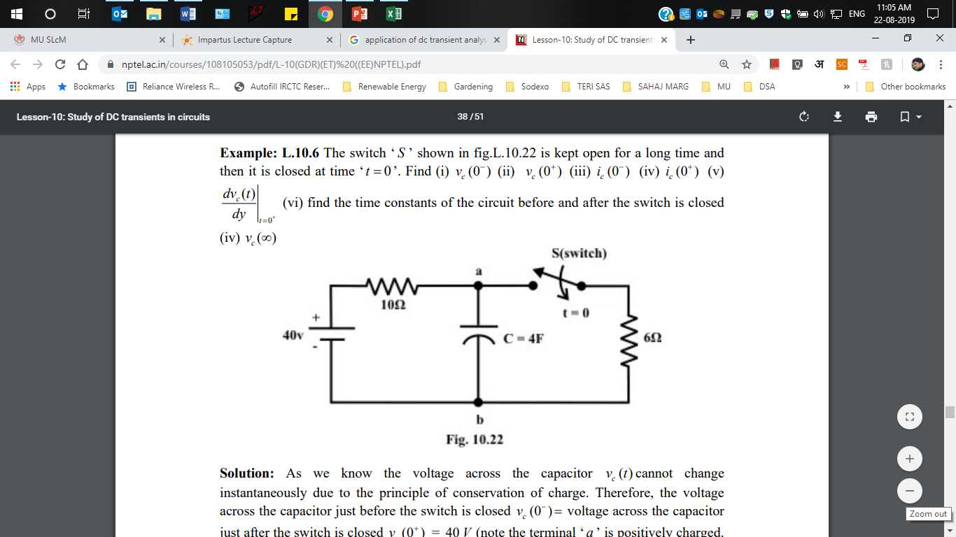
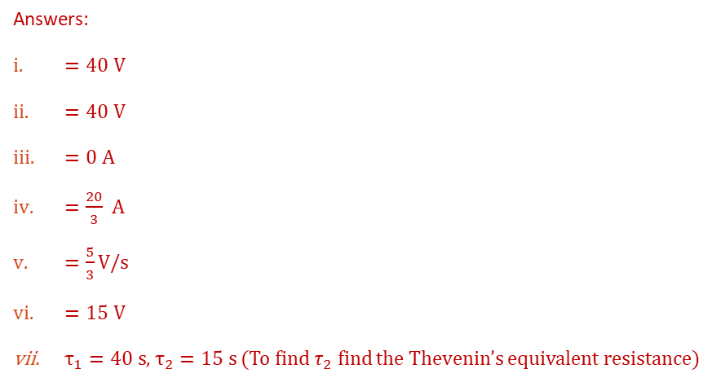
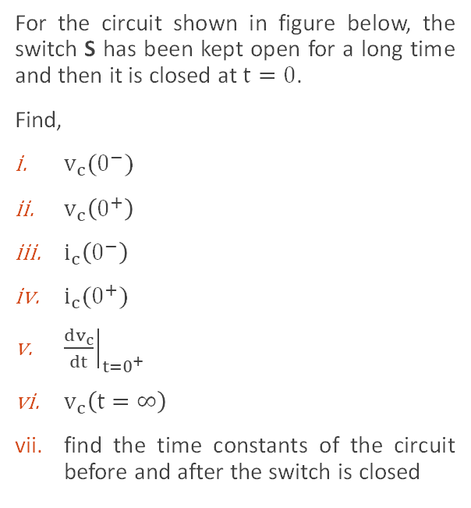
Q20
For the circuit shown in figure below, the switch S has been kept open for a long time and then it is closed at $t=0$.
Find,
$v_{c}(0^{−})$
$v_{c}\left(0^{+}\right)$
$i_{c}\left(0^{−}\right)$
$i_{c}(0^{+})$
${\left.\frac{dv_{c}}{dt}\right|}_{t=0^{+}}$
$v_{c}\left(t=∞\right)$
find the time constants of the circuit before and after the switch is closed
Answers:
$=40 V$
$=40 V$
$=0 A$
$=\frac{20}{3} A$
$=\frac{5}{3}V/s$
$=15 V$
$τ_{1}=40 s$, $τ_{2}=15 s$ (To find $τ_{2}$ find the Thevenin’s equivalent resistance)

Slide 22
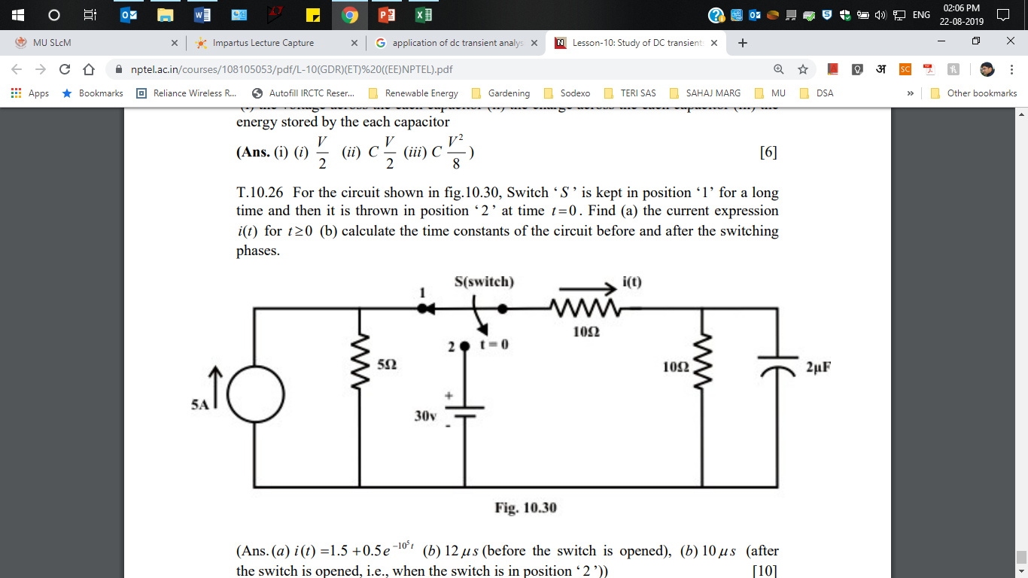
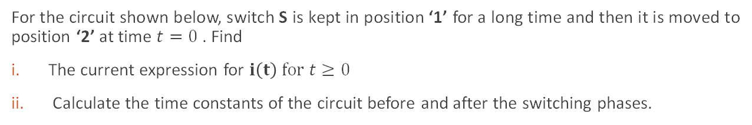
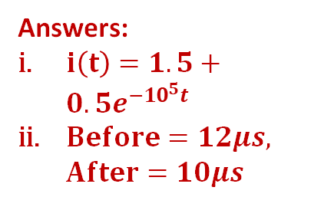
Q21
For the circuit shown below, switch S is kept in position ‘1’ for a long time and then it is moved to position ‘2’ at time $t=0$. Find
The current expression for $i\left(t\right) for t≥0$
Calculate the time constants of the circuit before and after the switching phases.
Answers:
$i\left(t\right)=1.5+0.5e^{−{10}^{5}t}$
$Before=12μs,$ $After=10μs$

